Slide 1
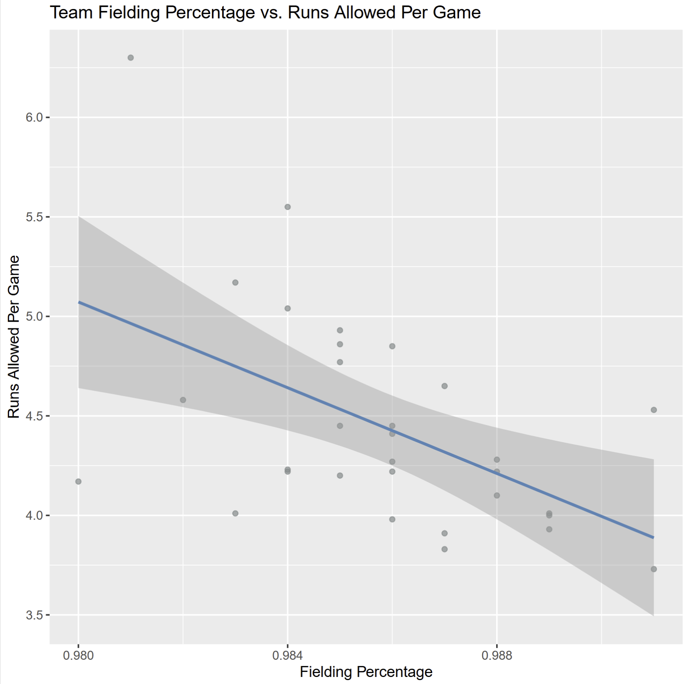
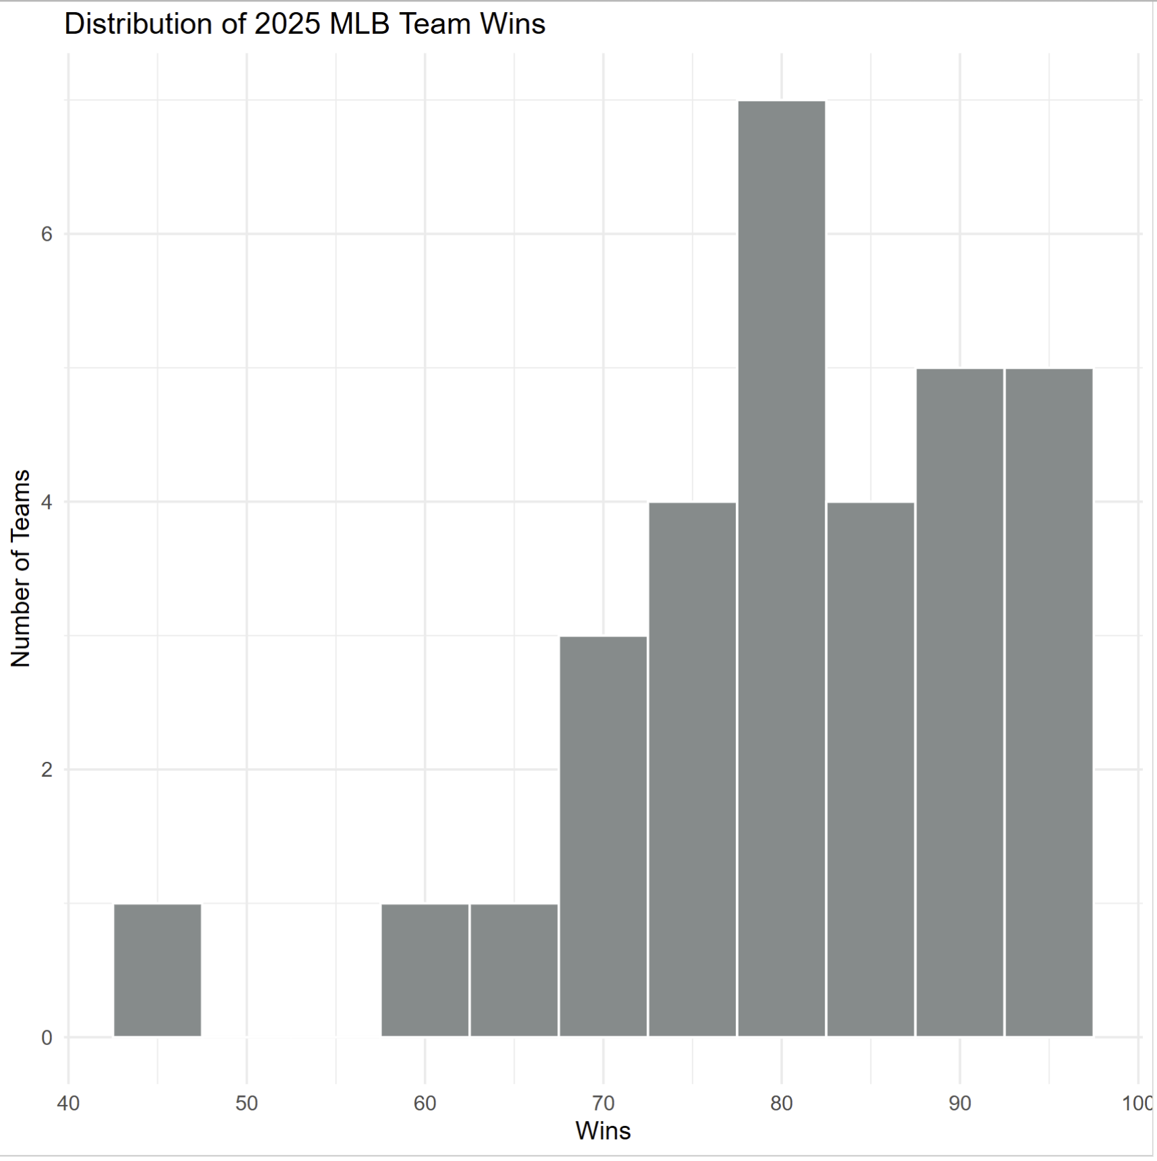
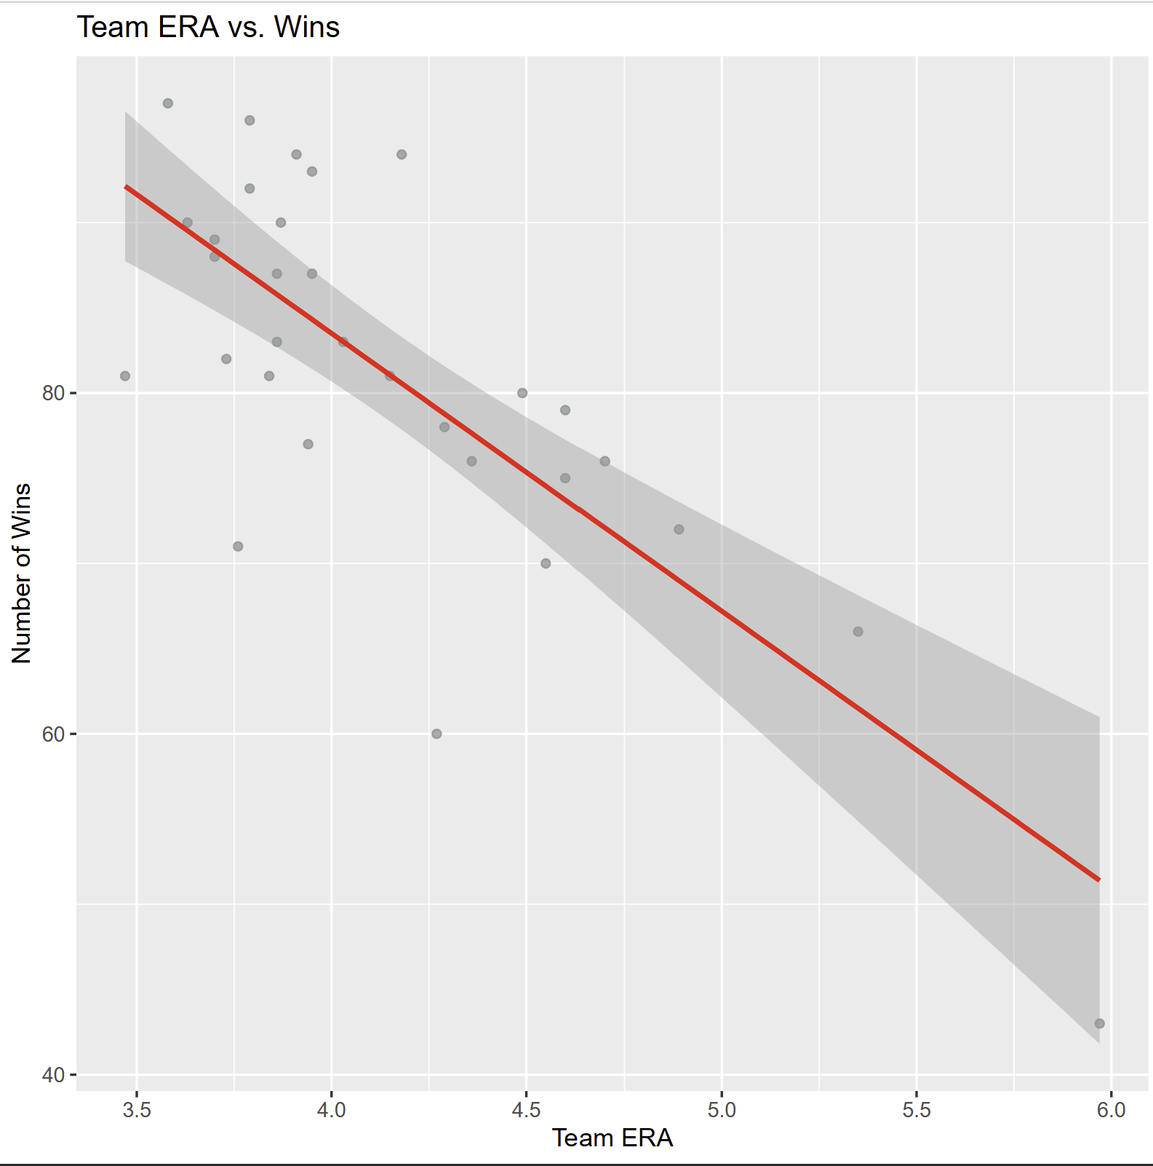
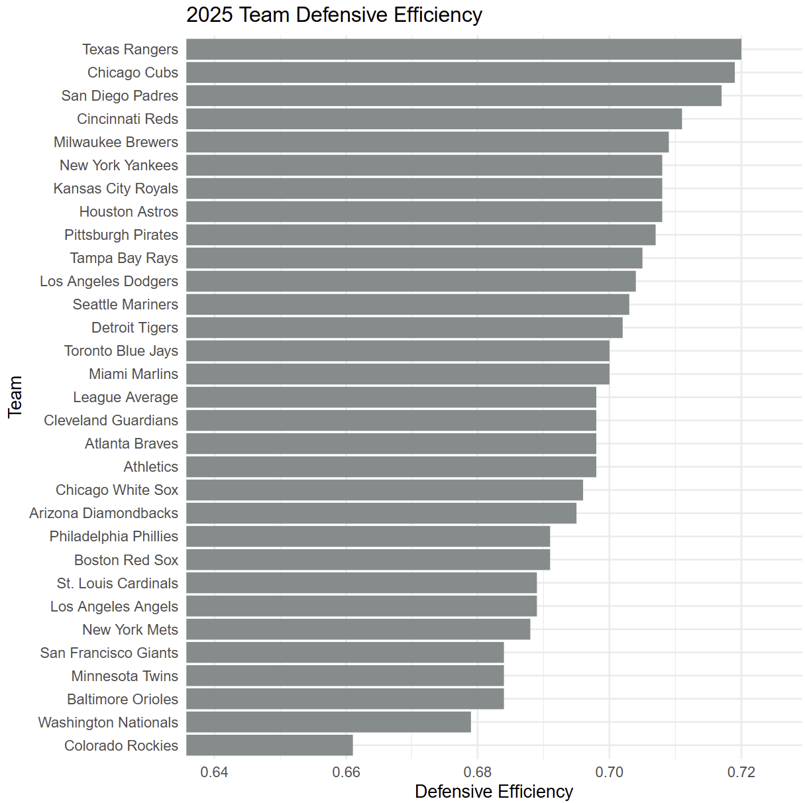
Which Batting, Pitching, and Fielding Metrics Contribute to MLB Team Wins?
By Peter Chapman
SPTM/SPAX212: Introduction to Sport Analytics at the University of Delaware
Introduction
Significant Batting Metrics
Importance of Fielding
Findings Summary
Goal: Determine important metrics for MLB team regular season wins in 2025
Research Question: Which batting, pitching, and fielding statistics are most significant?
Tools used: Microsoft Excel and R Studio
Certain batting, pitching, and fielding metrics are more significant than others in predicting the performance of an MLB team. Team earned run average (ERA) had a very strong negative relationship with team wins during the 2025 MLB regular season, with the correlation coefficient being -0.77. As team ERA increases, predicted wins decreases. The multiple linear regression between the hitting metrics and runs scored revealed some surprising results. The model was very strong, with the adjusted R-squared being 89.7%. Slugging percentage and on-base percentage each had strong positive relationships with runs scored. Surprisingly, team batting average had a negative relationship with runs scored. For the baserunning model, both stolen bases and number of times caught stealing were determined to be clinically significant with runs scored. An increase by one stolen base is associated with an increase of 1.0023 runs scored. An increase by one caught stealing attempt is associated with a decrease of 2.7794 runs scored. Fielding percentage had a moderate negative relationship with runs allowed per game, with a correlation coefficient of -0.52. Many of the most defensively efficient MLB teams in 2025 made the postseason.
Metric | Coefficient | T Statistic | P-Value
Constant | -805.1 | -7.061 | 1.36 * 10^-7
BA | -1473.7 | -1.805 | 0.0823
SLG | 1391.7 | 5.559 | 6.81 * 10^-6
OBP | 4207.3 | 5.191 | 1.82 * 10^-5
This regression results table shows which batting metrics at the plate are statistically significant with runs scored for the MLB teams. These metrics, abbreviated in the table above, are batting average, slugging percentage, and on-base percentage.
Adjusted R-squared: 0.897, very strong statistical relationship
89.7% of variability in team runs scored can be explained by batting average, slugging percentage, and on-base percentage
Slugging percentage and on-base percentage have strong positive relationships with runs scored
Surprisingly, team batting average does not
This scatter plot shows the relationship between team fielding percentage and runs allowed per game in 2025. Generally, runs allowed per game decreases as fielding percentage improves.
Correlation coefficient: -0.52
Moderate negative relationship between team fielding percentage and runs allowed per game
As team fielding percentage improves, the predicted runs allowed per game decreases
This is the distribution of MLB wins by team in 2025. Bins have a width of 5 wins. As seen above, many teams finished at around 80 regular season wins.
Impact of Baserunning Metrics
Team ERA vs. Wins
Metric | Coefficient | T Statistic | P-Value
Constant | 697.1422 | 14.718 | 1.05 * 10^-14
SB | 1.0023 | 2.024 | 0.0526
CS | -2.7794 | -1.55 | 0.1324
This regression results table shows which baserunning metrics are statistically significant with runs scored for the MLB teams. These metrics, abbreviated in the table above, are stolen bases and the number of times a team’s baserunner was caught stealing.
Strategic Recommendations
General managers and coaches can learn a lot from these research findings. From a roster construction standpoint, it is clear which skills are necessary, and which are not. General managers should prioritize position players who can get on base, hit for power, run the bases well, and accurately field their position. Baseball executives should target starting and relief pitchers who excel in the statistic of earned run average. If the fielders behind them can field their positions, the team will most likely win a lot of games. For coaches, the winning strategy is very clear. Players should be instructed to prioritize getting on base in any way possible, even if it is not a hit. Spring training and in-season training should be used to teach players how to effectively run the bases and field their positions. This will allow the team to be defensively efficient and dangerous on the bases once the regular season starts.
Adjusted R-squared: 0.06673, very weak statistical relationship
6.673% of variability in team runs scored can be explained by stolen bases and caught stealing outs
The weakness of the model makes sense, as a large amount of the variability in runs scored comes from slugging percentage, on-base percentage, and team batting average
Stolen bases and number of caught stealing attempts are both clinically significant with runs scored
An increase by one stolen base is associated with an increase of 1.0023 runs scored
An increase by one caught stealing attempt is associated with a decrease of 2.7794 runs scored
This scatter plot shows the relationship between team ERA and wins in 2025. Generally, wins decrease as team ERA increases.
Correlation coefficient: -0.77
Very strong negative relationship between team ERA (earned run average) and wins
As team ERA increases, predicted wins decreases
This bar chart shows each MLB team ranked by their defensive efficiency during the 2025 MLB season. Although not a perfect predictor, many of the teams near the top (Cubs, Padres, Reds, Brewers, Yankees, Astros) all made the playoffs this past season. Many of the teams near the bottom of the bar chart (Rockies, Nationals, Orioles, Twins) finished near the bottom of the league in wins.

